Slide 1

“Is It Lawful?” Matthew 19:3-20

Slide 2

Some Pharisees came to him to test him. They asked, “Is it lawful for a man to divorce his wife for any and every reason?”

Slide 3
“Haven’t you read,” he replied, “that at the beginning the creator made them male and female,”

Slide 4
and said, ”For this reason a man will leave his father and mother and be united to his wife, and the two will become one flesh?

Slide 5
So they are no longer two, but one. Therefore what God has joined together, let man not separate.”

Slide 6
“Why then,” they asked, “did Moses command that a man give his wife a certificate of divorce and send her away?”

Slide 7
Jesus replied, “Moses permitted you to divorce your wives because your hearts were hard. But it was not this way from the beginning.

Slide 8
I tell you that anyone who divorces his wife, except for marital unfaithfulness, and marries another woman commits adultery.”

Slide 9
The disciples said to him, “If this is the situation between a husband and wife, it is better not to marry.”

Slide 10
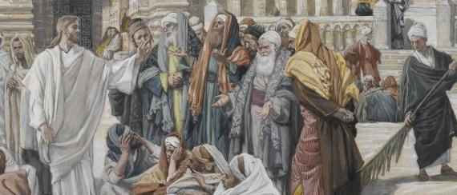
Is It lawful.

Slide 11

Hearts were hardened.

Slide 12

In the beginning.

