Slide 1

The Reign
Of God
1 Timothy 2:1-8

Slide 2

I urge, then, first of all, that requests, prayers, intercession and thanksgiving be made for everyone—for kings and those in authority,

Slide 3
that we may live peaceful and quiet lives in all godliness and holiness.

Slide 4
This is good, and pleases God our Savior, who wants all men to be saved and to come to a knowledge of the truth.

Slide 5
For there is one God, and one mediator between God and men, the man Christ Jesus,

Slide 6
who gave himself as a ransom for all men— the testimony given in its proper time.

Slide 7
And for this purpose I was appointed a herald and an apostle—
I am telling the truth,
I am not lying—and a teacher of the true faith to the Gentiles.

Slide 8
I want men everywhere to lift up holy hands in prayer, without anger or disputing.

Slide 9
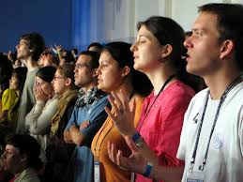
Do we, members of the church, accept these elders and deacons as chosen by God though the voice of this congregation, to lead us in the way of
Jesus Christ? (WE DO)

Slide 10
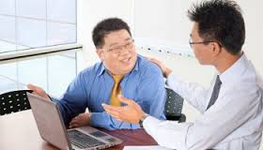
Do we agree to encourage them, and respect their decisions, and to follow as they guide us, serving Jesus Christ, who alone is head of the church?
(WE DO)

Slide 11
Brothers, I do not consider myself yet to have taken hold of it.
But one thing I do: Forgetting what is behind and straining toward what is ahead,

Slide 12
I press on toward the goal to win the prize for which God has called me heavenward in Christ Jesus.

Slide 13
All of us who are mature should take such a view of things.

Slide 14
And if on some point you think differently, that too God will make clear to you.
Only let us live up to what we have already attained.

Slide 15
Join with others in following my example, brothers, and take note of those who live according to the pattern we gave you.

Slide 16
For, as I have often told you before and now say again even with tears, many live as enemies of the cross of Christ.

Slide 17
Their destiny is destruction, their god is their stomach, and their glory is in their shame.

Slide 18
Their mind is on earthly things. But our citizenship is in heaven.

Slide 19
And we eagerly await a Savior from there, the Lord Jesus Christ,
Philippians 3:13-20

