Slide 1

“We Believe In The Holy Spirit” John 14:16-20

Slide 2
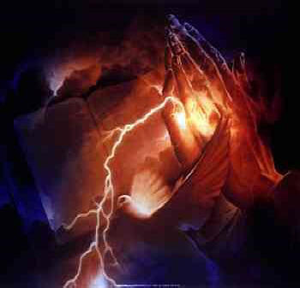
“We Believe In The Holy Spirit” John 14:16-20

Slide 3
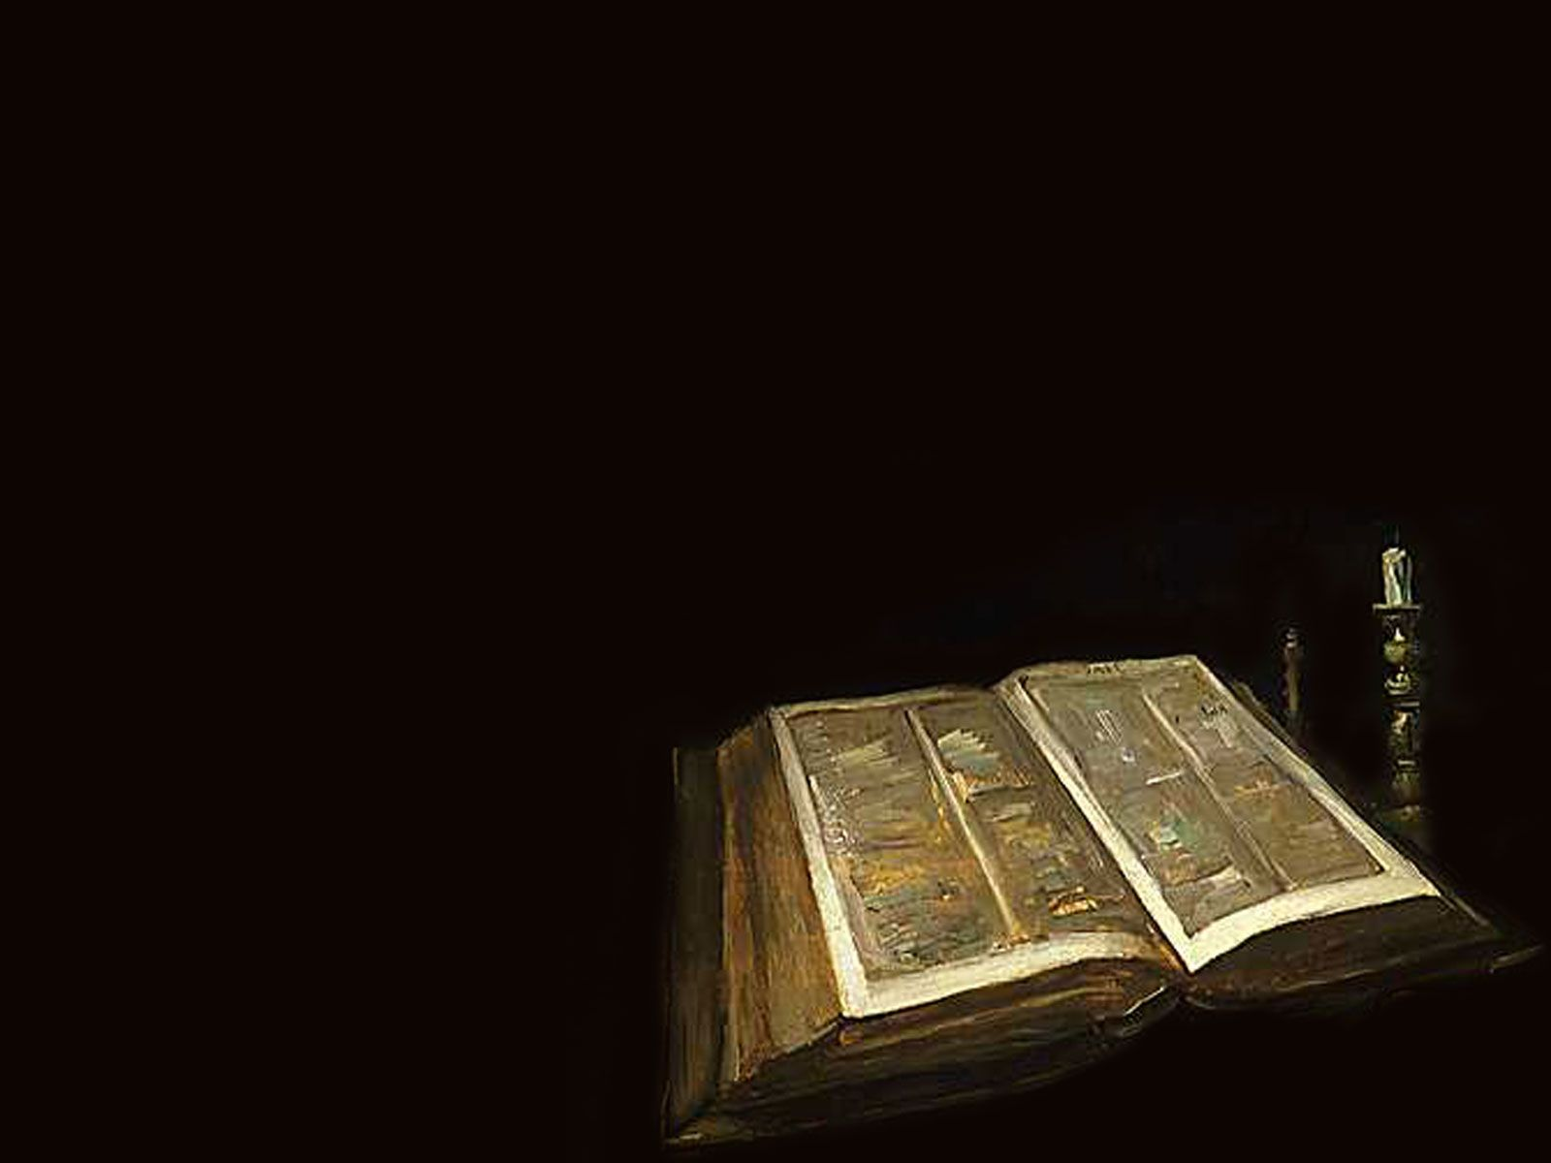
And I will ask the Father, and he will give you another Counselor to be with you Forever—the Spirit of truth

Slide 4
The world cannot accept him, because it neither sees him nor knows him.

Slide 5
But you know him, for he lives with you and will be in you. I will not leave you as orphans; I will come to you.

Slide 6
Before long, the world will not see me anymore, but you will see me. Because I live, you also will live.

Slide 7
On that day you will realize that I am in my Father, and you are in me, and I am in you.”

Slide 8

The Creed says: “I believe in the Holy Spirit.”

Slide 9
THE APOSTLE’S CREED I believe in God, the Father almighty, Creator of Heaven and Earth.

Slide 10
I believe in Jesus Christ, his only Son, our Lord.

Slide 11
He was conceived by the power of the Holy Spirit and born of the Virgin Mary.

Slide 12
He suffered under Pontius Pilate, was crucified, died, and was buried.

Slide 13
He descended to the dead. On the third day he rose again.

Slide 14
He ascended into Heaven, and is seated at the right hand of the Father. He will come again to judge the living and the dead.

Slide 15
I believe in the Holy Spirit, the holy and universal Church,

Slide 16
the communion of saints, the forgiveness of sins, the resurrection of the body, and the life everlasting. Amen

Slide 17

The Apostle’s Creed is divided into three major parts. The first part expresses what we believe about God the Father,

Slide 18
the second states what we believe about God the Son, and the third is what we believe about the Holy Spirit.

Slide 19

The Holy Spirit is a person. John 14:16-18

Slide 20
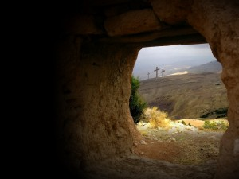
The Holy Spirit is personal. John 16:7-8 2 Corinthians 5:17 John 1:12-13 Romans 8:9

Slide 21
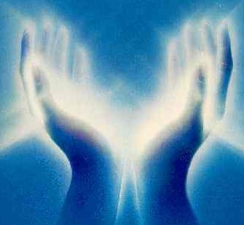
The Holy Spirit purifying us. 1 Corinthians 6:19-20 Ephesians 4:30;1:11-13 2 Corinthians 1:21-22 Jude 1:24 Hebrews 5:15

