Slide 1

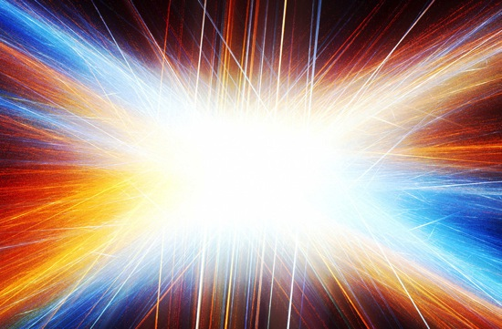
“I Believe In The Resurrection of the Body And the Life Everlasting” 1 Corinthians 15:42-58

Slide 2
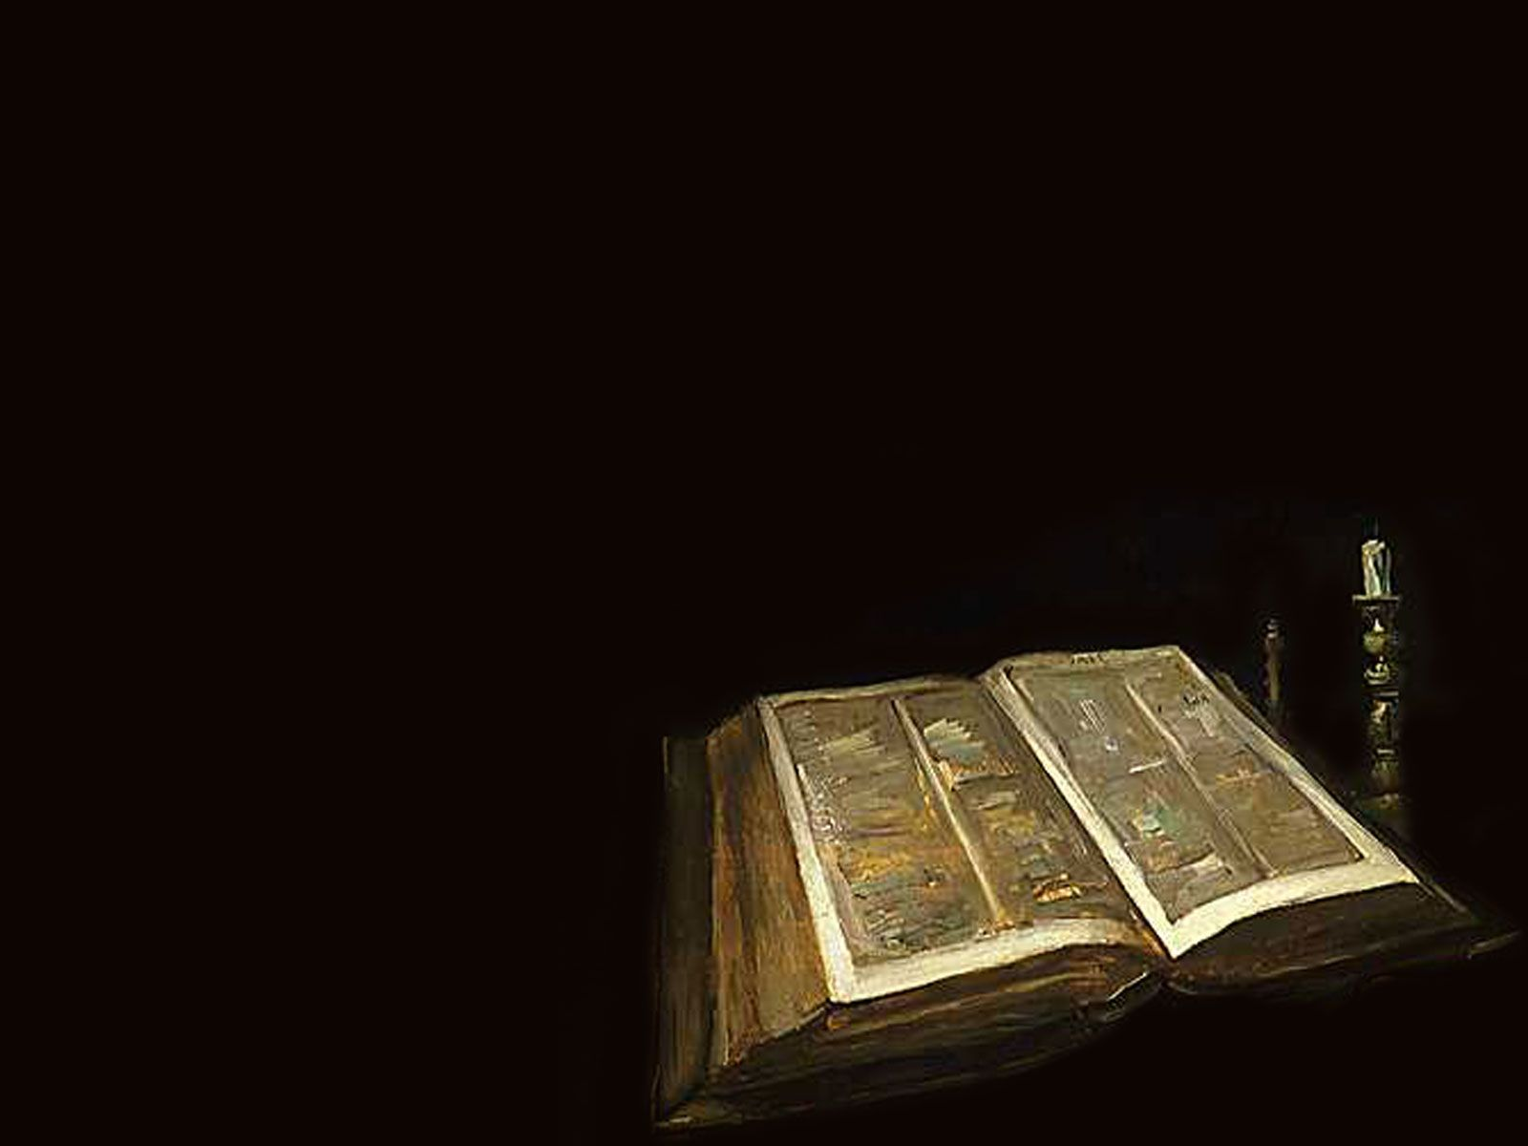
So will it be with the resurrection of the dead.

Slide 3
The body that is sown is perishable, it is raised imperishable;

Slide 4
it is sown in dishonor, it is raised in glory; it is sown in weakness, it is raised in power;

Slide 5
it is sown a natural body, it is raised a spiritual body. If there is a natural body, there is also a spiritual body.

Slide 6
So it is written: “The first man Adam became a living being”; the last Adam, a life-giving spirit.

Slide 7
The spiritual did not come first, but the natural, and after that the spiritual.

Slide 8
The first man was of the dust of the earth, the second man from heaven.

Slide 9
As was the earthly man, so are those who are of the earth; and as is the man from heaven, so also are those who are of heaven.

Slide 10
And just as we have borne the likeness of the earthly man, so shall we bear the likeness of the man from heaven.

Slide 11
I declare to you, brothers, that flesh and blood cannot inherit the kingdom of God, nor does the perishable inherit the imperishable.

Slide 12
Listen, I tell you a mystery: We will not all sleep, but will all be changed—in a flash, in the twinkling of an eye, at the last trumpet.

Slide 13
For the trumpet will sound, the dead will be raised imperishable, and we will be changed.

Slide 14
For the perishable must clothe itself with the imperishable, and the mortal with immortality.

Slide 15
When the perishable has been clothed with the imperishable, and the mortal with immortality,

Slide 16
then the saying that is written will come true: “Death has been swallowed up in victory.”

Slide 17
“Where, O death is your victory? Where, O death, is your sting.” The sting of death is sin, and the power of sin is the law.

Slide 18
But thanks be to God! He gives us the victory through our Lord Jesus Christ.

Slide 19
Therefore, my dear brothers, stand firm. Let nothing move you.

Slide 20
Always give yourselves fully to the work of the Lord, because you know that your labor in the Lord is not in vain.

Slide 21

God has created us for immortality. Jesus said, “Because I live, you also will live. ”John 14:19

Slide 22
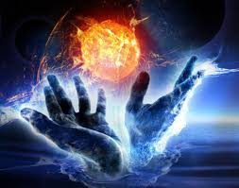
God will give us transformed bodies.

Slide 23
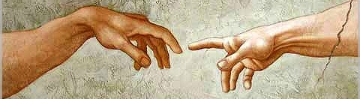
“...flesh and blood cannot inherit the kingdom of God. … For our perishable earthly bodies must be transformed into heavenly bodies that will never die.” 1 Corinthians 15:50-54

Slide 24
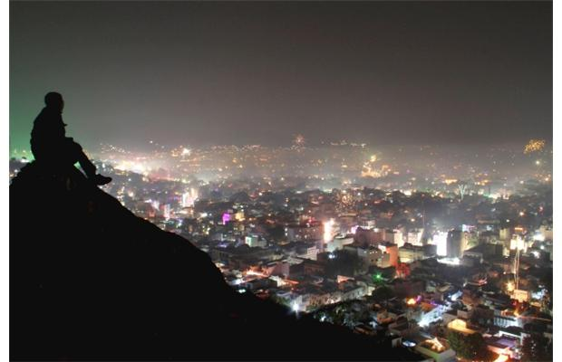
God’s gift of immortality changes our life perspective. Hebrews 12:1 Matthew 8:11

Slide 25
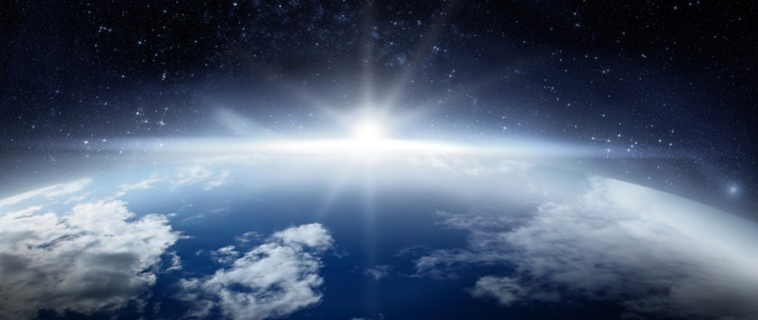
“Behold, I will create new heavens and a new earth. The former things will not be remembered, nor will they come to mind.” Isaiah 65:17

Slide 26
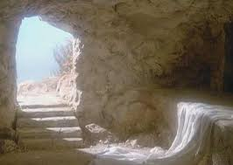
“Where, O death, is your victory? Where, O death, is your sting? The sting of death is sin, And the power of sin is the law.

Slide 27
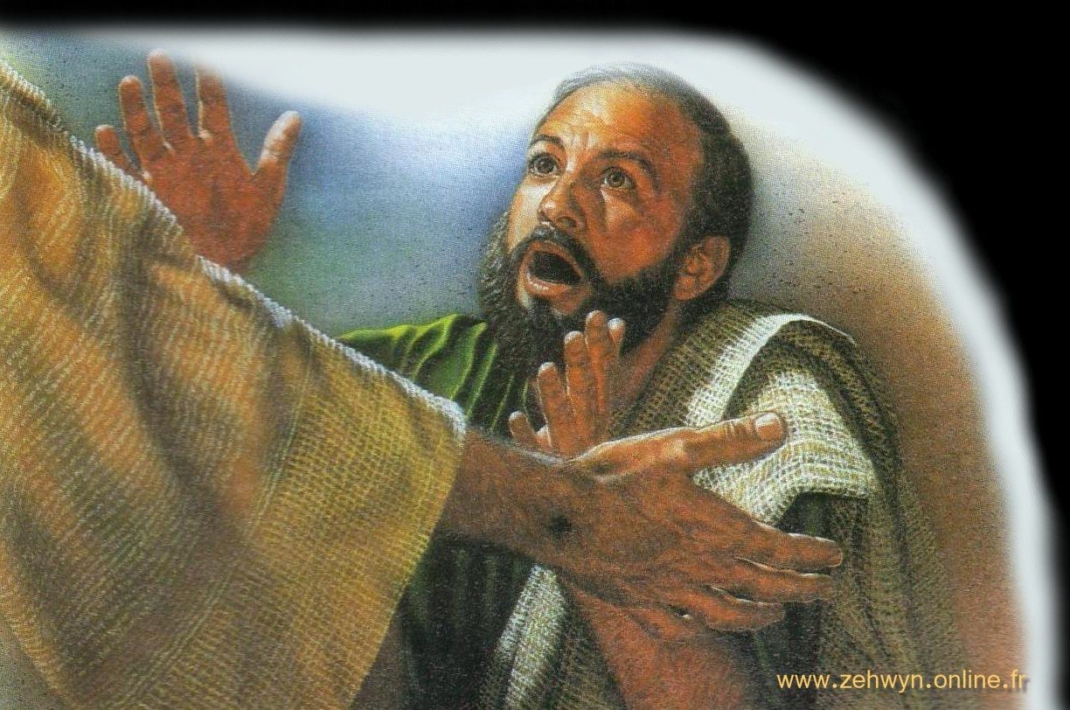
But thanks be to God! He give us the victory Through our Lord Jesus Christ.” 1 Corinthians 15:55-57

