Slide 1
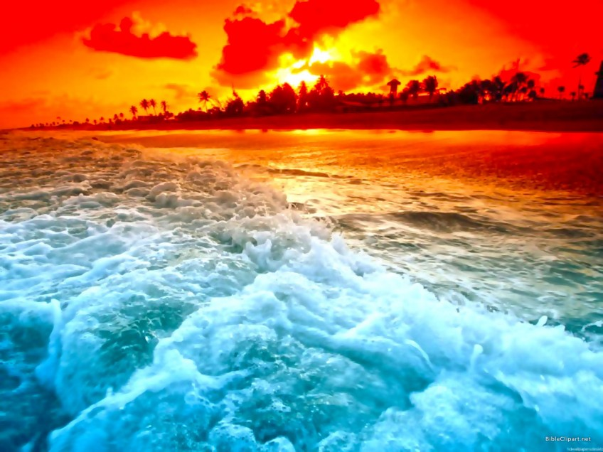
I Believe in God the Father Almighty
Psalm 53:1-6

Slide 2
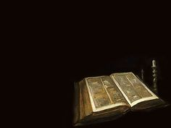
The fool says in his heart, “There is no God.”
They are corrupt, and their ways are vile; there is no one who does good.

Slide 3
God looks down from heaven on the sons of men to see if there are any who understand, any who seek God.

Slide 4
Everyone has turned away, they have together become corrupt, there is no one who does good, not even one.

Slide 5
Will the evildoers never learn—those who devour my people as men eat bread and who do not call on God?

Slide 6
There they were, overwhelmed with dread, where there was nothing to dread.

Slide 7
God scattered the bones of those who attacked you; you put them to shame, for God despised them.

Slide 8
Oh, that salvation for Israel would come out of Zion!

Slide 9
When God restores the fortunes of his people, let Jacob rejoice and Israel be glad!

Slide 10
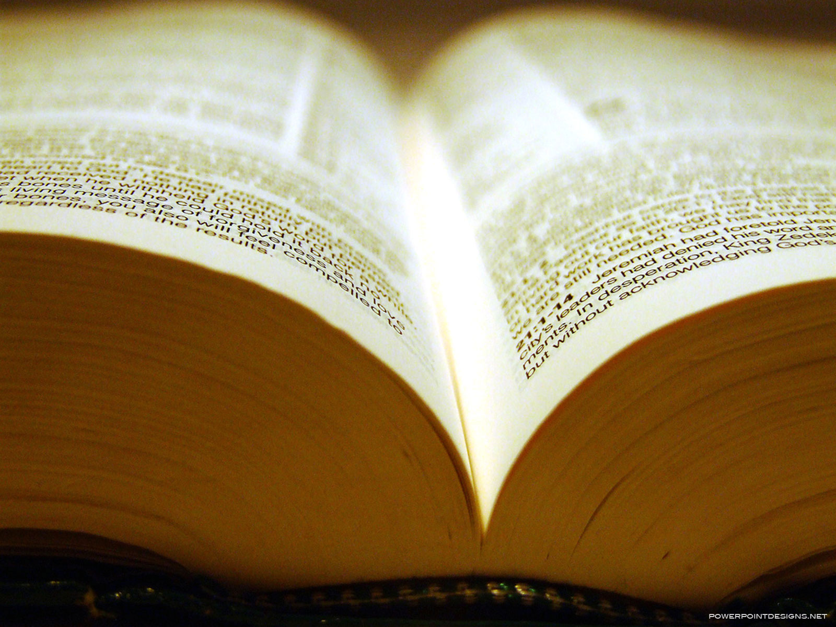
“The fool says in his heart, “There is no God.”
Psalm 53:1

Slide 11
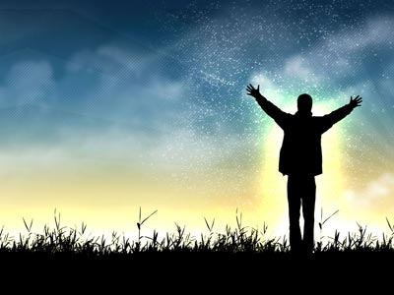
“I believe in God, the Father almighty,
Creator of Heaven and Earth.”
Apostle’s Creed

Slide 12

God is a given and God is almighty.

Slide 13
God is a particular God, a God who reveals himself, not a God of man’s creation.

Slide 14
Knowing God comes by faith before understanding, not after understanding.

Slide 15
We believe in a God who loves us as a father.

Slide 16
“Is there anyone around to save Israel?
God turns life around.
Turned-around Jacob skips rope, turned-around Israel sings laughter.”
Psalm 53:6 The Message

